Slide 1
CORDA: Committee on Research, Data & Assessment
SAA DATAVERSE
OPEN HOUSE
February 12, 2021

Slide 2
Agenda
Welcome/Introduction
What is SAA Dataverse?
Collection Development Policy
Methodology and examples
Review by section
Looking Ahead
Dataverse
Education & Outreach
Facts & Figures

Slide 3
Introduction
Welcome
Chat rules
#callonme
#askforme

Slide 4
CORDA Membership 2020-2021
Jennifer King (Co-Chair)
Erin Passehl Stoddart (Co-Chair)
Sarah Buchanan
Gwendolyn Higgins
Cristina Horak
Emily Lapworth
Chris Marino
Dennis Meissner
Sarah Pratt
Mary Biddle, Early Career Member
Paul Conway, Ex Officio
Carli Lowe, Education Committee Liaison
Nancy McGovern, Ex Officio
Ricardo Punzalan, Council Liaison
Nancy Beaumont, Staff Liaison

Slide 5
SAA Dataverse: A Brief Background
Environmental scan of social science data and education repositories in 2019
Narrowed down to Dataverse, an open-source repository software application developed at Harvard University for archiving, sharing, and accessing research data
Ongoing meetings with Odum Institute for Research in Social Science at the University of North Carolina at Chapel Hill resulted in signed MOU in January 2021
SAA Dataverse pilot repository in 2020, officially published this week!
Currently 1 dataset: original A*CENSUS from 2004

Slide 6
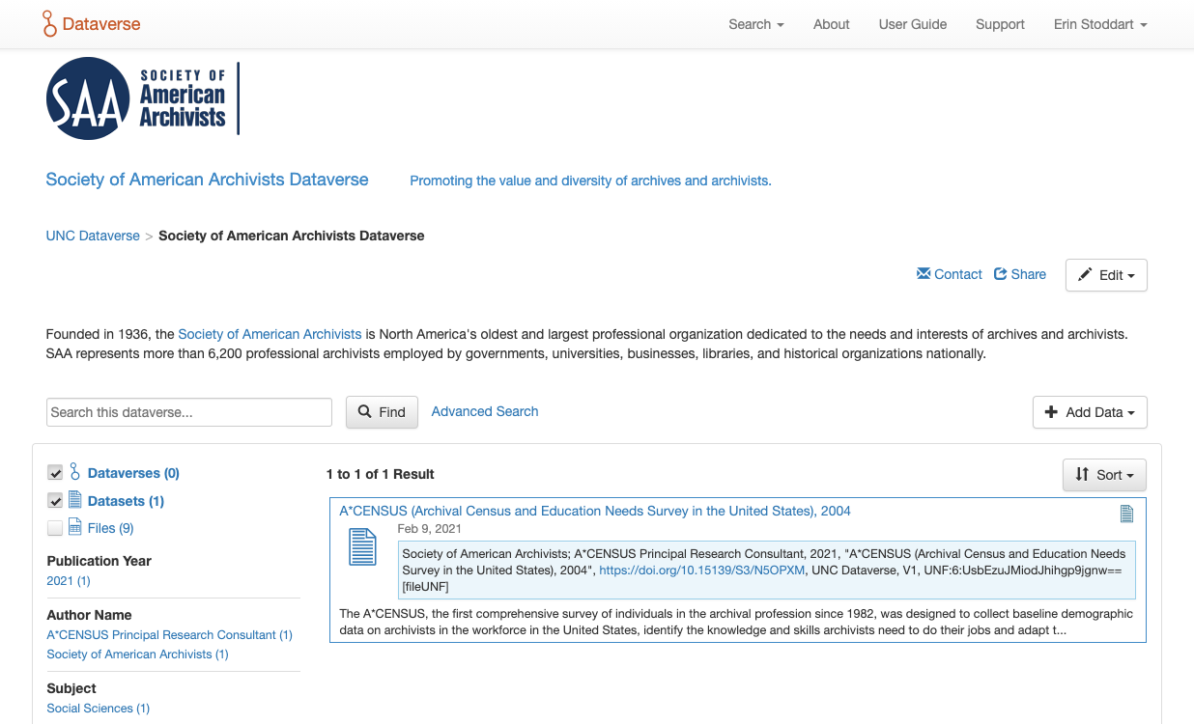
https://dataverse.unc.edu/dataverse/saa
Landing page

Slide 7
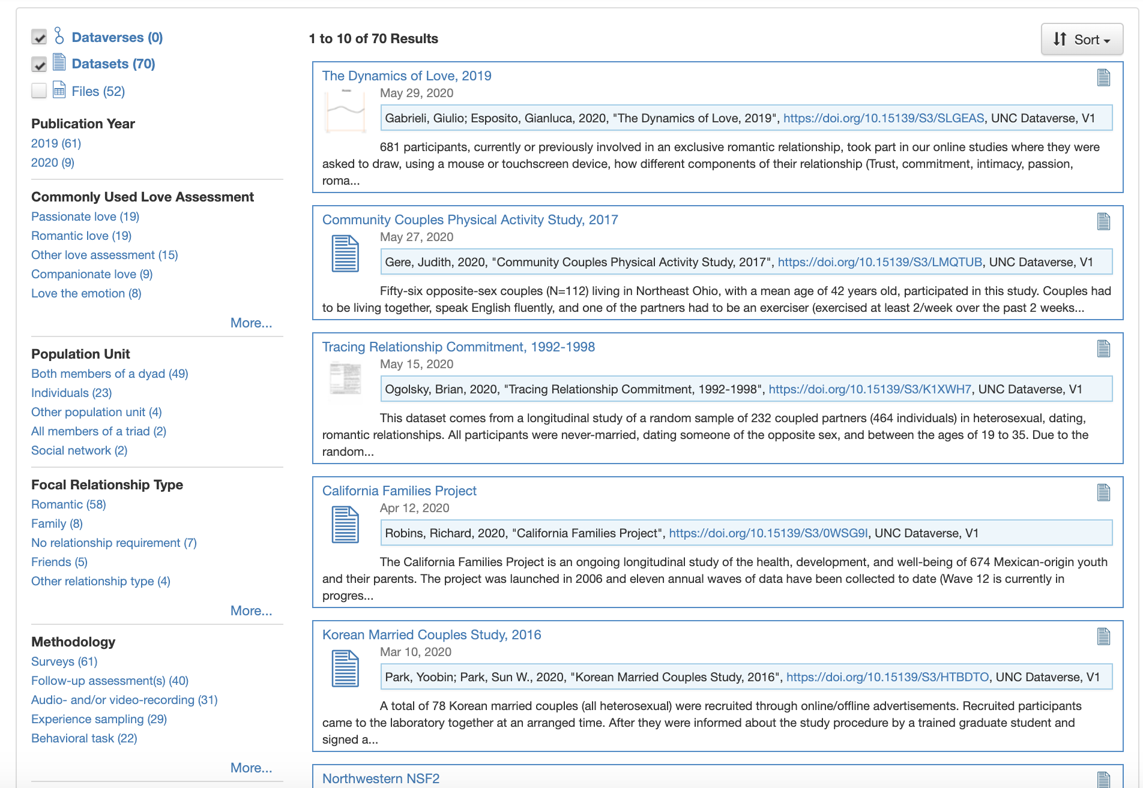
Another Dataverse Example: Landing Page for The Love Consortium

Slide 8
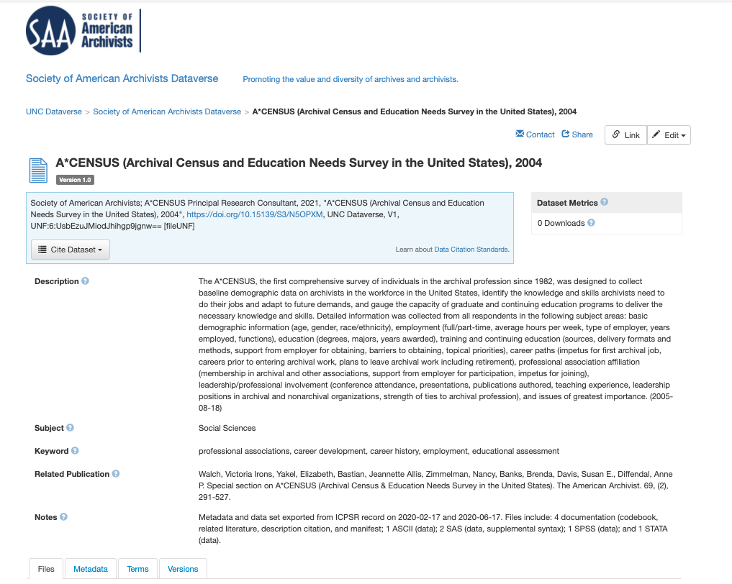
Dataset view

Slide 9
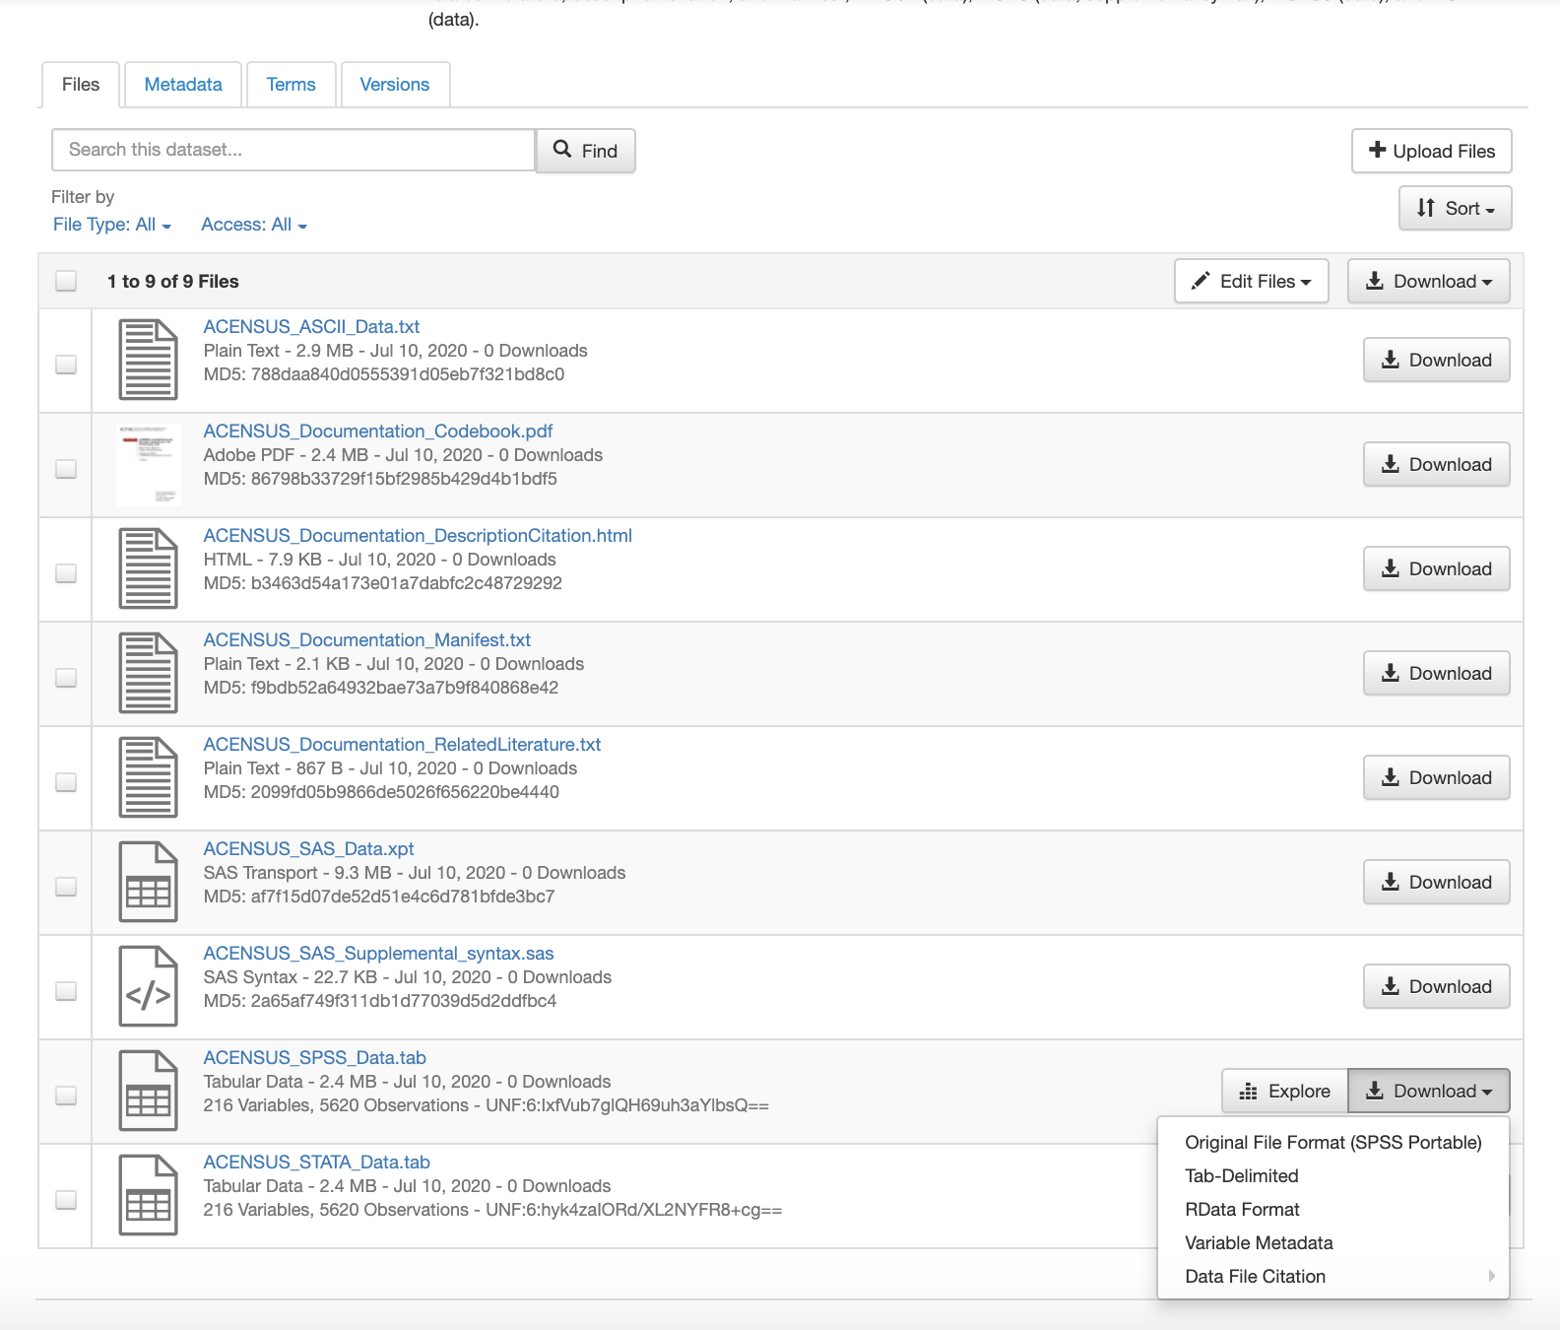
Associated data files in multiple accepted formats

Slide 10
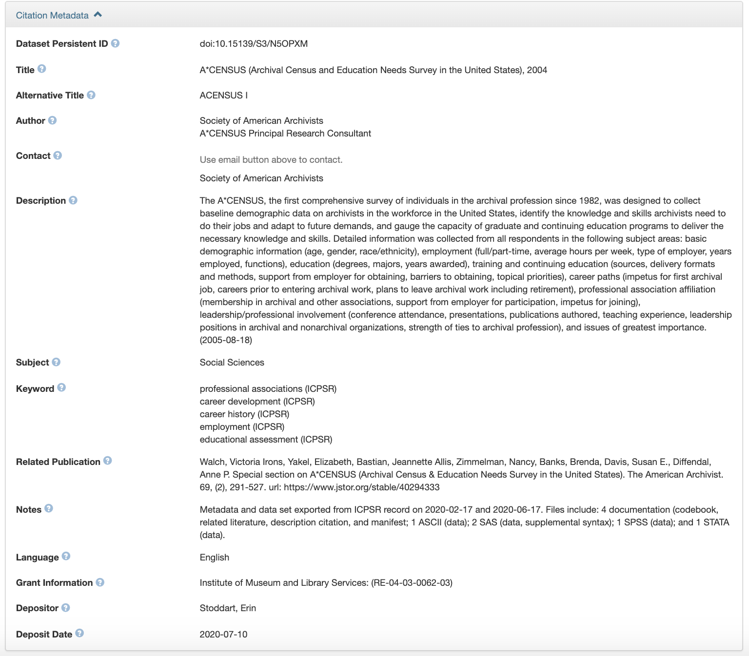
Citation Metadata

Slide 11
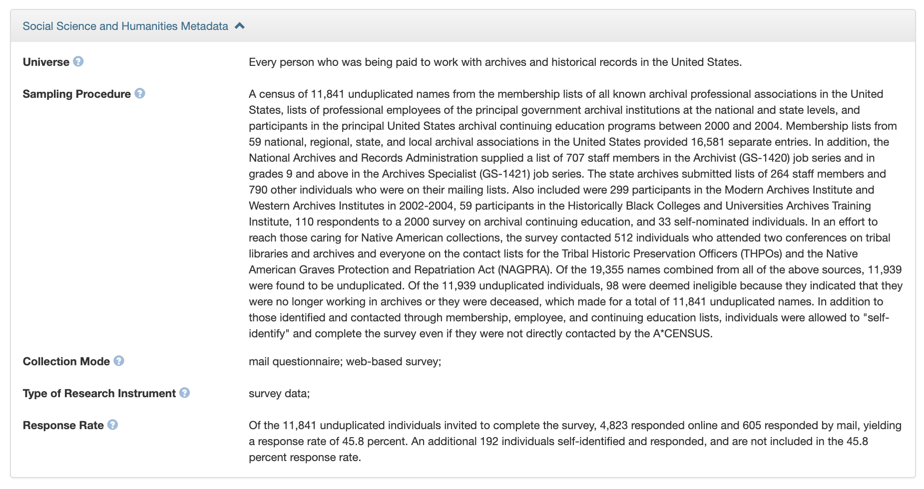
Advanced Metadata: Science Science and Humanities

Slide 12
Collection Development Policy
Methodology and Examples
Review by Section
Can follow along in the shared document
Send suggestions or ideas to Suggestion Box (link in agenda)

Slide 13
Statement of Purpose
The Society of American Archivists (SAA) Dataverse is an SAA data service that was established to support the needs and interests of SAA's members and the broader archives community. The SAA Dataverse supports the reuse of datasets for purposes of fostering knowledge, insights, and a deeper understanding of archival organizations, the status of archivists, and the impact of archives and archival work on the broader society. Deposited datasets should be “actionable” in that they should support direct analysis and interpretation. The SAA Dataverse welcomes deposits of collections of quantitative or qualitative data and associated documentation.

Slide 14
Guiding Principles and Collecting Focus (1)
The SAA Dataverse supports active data reuse and reevaluation on behalf of the archival community.
The SAA Dataverse will adhere to FAIR Guiding Principles for Scientific Data Management and Stewardship (Findable, Accessible, Interoperable, and Reusable).
The SAA Dataverse systems, policies, and procedures align with standards for trustworthy digital repositories, providing long-term data archiving, bit-level preservation, and data sharing that foster analysis, reuse, and new interpretations.
The scope of the data and associated documentation must have clear potential value to one or more of four designated communities:
Archives and records professions in North America
Society of American Archivists
Archival repositories
Individual professional archivists and archival scholars

Slide 15
Guiding Principles and Collecting Focus (2)
The SAA Dataverse welcomes data created by the SAA community and allied organizations and individuals.
SAA requires that SAA-sponsored data be submitted for deposit. This includes data gathered by the Council, all component groups, work supported by SAA Foundation funding, and selected materials related to the SAA Research Forum
Archival repositories that gather data of interest and usefulness beyond the originating organization
Individual professional archivists and archival scholars who gather data of broad interest and value
SAA will prioritize data identified by and solicited for deposit by CORDA in its role as developer and manager of the SAA Dataverse repository.

Slide 16
Submission Requirements & Data Formats (1)
Datasets and associated documentation must conform to the SAA Dataverse Terms of Use and SAA Dataverse Data Deposit Form. (link once ready). Submissions will be reviewed by the co-Chairs and/or review committee of SAA’s Committee on Research, Data, and Analysis (CORDA), and ingest will be depend on adherence to the Guiding Principles and Collecting Focus. Review does not include assessment of methodology used.
Data should provide information about:
Origins of the dataset;
Methodologies for gathering, preparing, and analyzing the data;
Any analyses or reports that are derived from the data, either published or unpublished.

Slide 17
Submission Requirements & Data Formats (2)
Associated documentation can take the form of:
Tabular data (including Excel, CSV, R, Stata, SPSS, tab-delimited files)
Image files (.jpg, .png. .tif)
Geospatial files
File types that are widely accepted, that can be converted, and that are non-proprietary/open source (PDF, etc.).
All contextual information necessary to understand and use the data (such as readme files, checklists, etc.) is a mandatory component of the dataset. The submitter must remove all personally identifiable information (PID). The submitter must supply metadata to the fullest extent possible at the time of ingestion.

Slide 18
Preservation
The SAA Dataverse is hosted by the Odum Institute for Research in Social Science at the University of North Carolina at Chapel Hill, which is a trusted repository for research data, datasets, and associated research whose mission is to provide long-term data archiving and data sharing. The Odum Institute’s systems, policies, and procedures have been developed in alignment with standards for trustworthy digital repositories as outlined in ISO 14721 Reference Model for an Open Archival Information System (OAIS) and ISO 16363 Audit and Certification of Trustworthy Digital Repositories. Data is preserved at the bit-level. Deposited items will be retained for the lifetime of the SAA Dataverse.

Slide 19
Copyright and Intellectual Property Rights
All datasets and supporting documentation must be granted for distribution in the SAA Dataverse. Uploaded materials must be made freely available via a Creative Commons license. Datasets and associated documentation may be deposited in repositories outside of the SAA Dataverse if permission and copyright allow.

Slide 20
Deaccessioning
Deaccessioning records from the SAA Dataverse should occur only if there is a legal or otherwise valid reason for the dataset to no longer be accessible to the public. If a record must be deaccessioned, a version of the dataset or the entire dataset may be deaccessioned. If a record was published for any amount of time, a “tombstone page” will remain for records or data that have been deaccessioned to indicate its removal. Submitters must work with CORDA to deaccession data or records.

Slide 21
Looking Ahead
Dataverse development
Education & Outreach update
Next open house: discussion of CORDA’s preliminary working definitions
Annual meeting
Facts & Figures update

Slide 22
Reimagining Facts & Figures

Slide 23
Open Discussion

